Slide 1
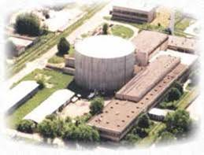
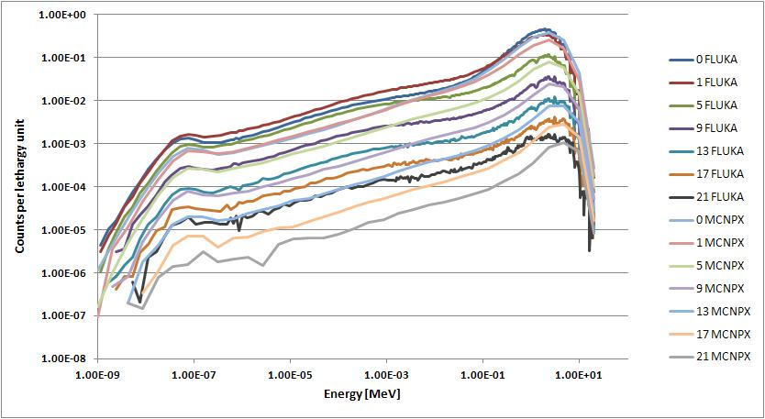
Methods and Instruments for Dosimetric Measurements in Mixed Neutron-Gamma Radiation Fields
NATALIA GOLNIK
NATIONAL CENTRE FOR NUCLEAR RESEARCH

Slide 2

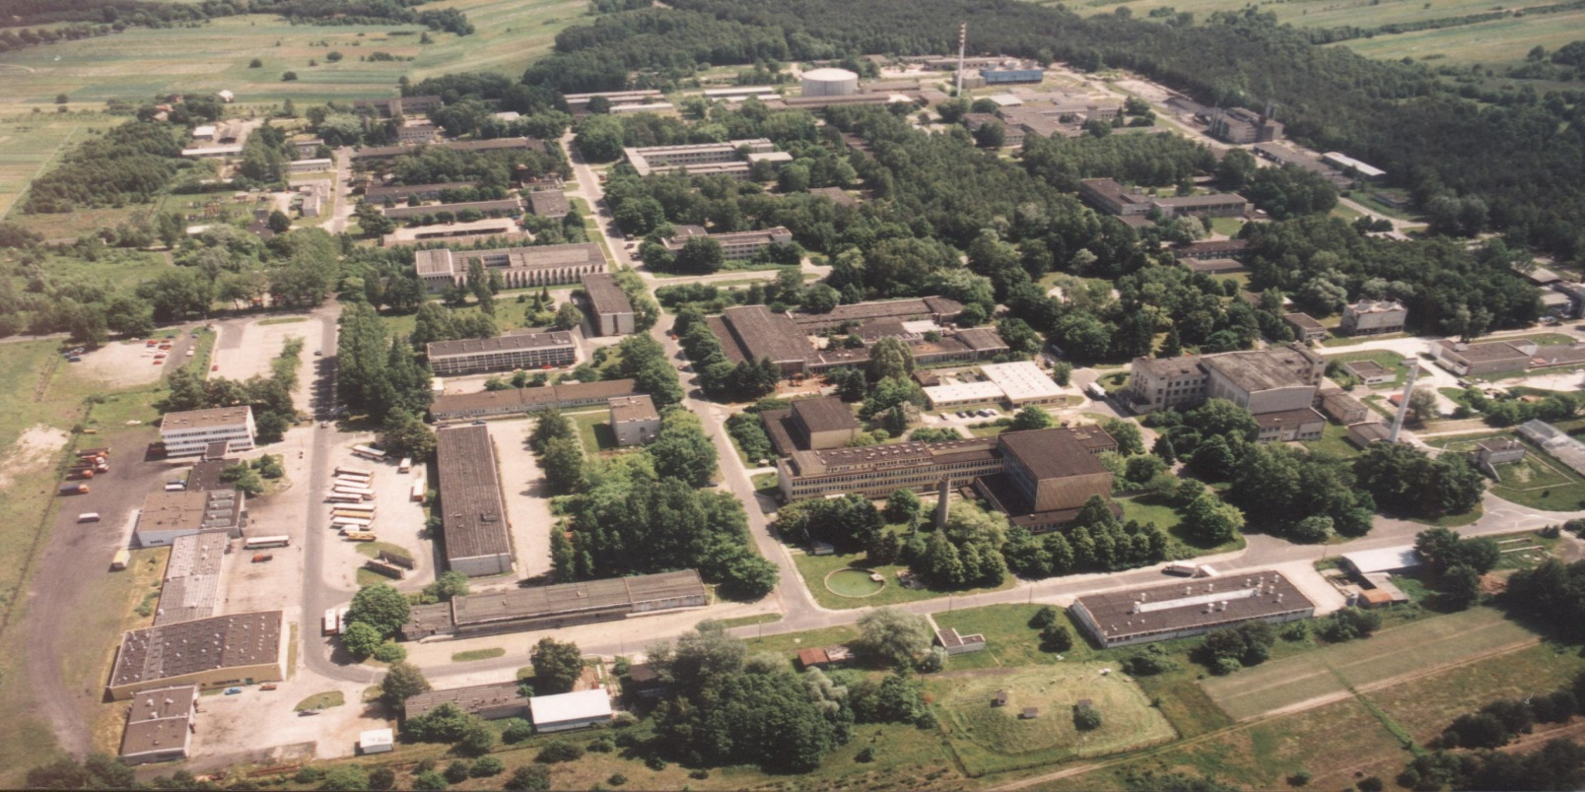
NCBJ in OTWOCK-ŚWIERK
MARIA reactor
Laboratory for Mixed Radiation Dosimetry

Slide 3
Neutron dosimetry
The basic protection quantity for ionising radiation is the absorbed dose in an organ or tissue.
Because different types of radiations have different degrees of biological effectiveness account must be taken for radiation type.
The concept of weighted dose seems at present the best available.
The present system, recommended by ICRP involves a complex combination of effective dose, the so called „protection quantity” which is used in legislation and the operational quantities which instruments and dosemeters should realise.

Slide 5
Neutron dosimetry
Aongside the problems of the compatibility of the protection and operational quantities there remains the problem of providing devices which measure the operational quantities accurately, in a routine and simple way.
There remains much to do if such devices are to become widely available.

Slide 6
U
C
NU
NC
U
DLT

Slide 7


1. Calibration laboratory
P. Tulik, Sz. Domański
Neutron sources
²⁴¹Am Be, ²⁵²Cf, traceable to National Physical Laboratory, UK,
²³⁹Pu Be
Sources can be exposed free in air or in modifying filters.
Dose equivalent rate: 2 ÷1400 μSv/h.
¹³⁷Cs gamma sources give fields traceable to Polish Committee for Normalisation and Measurements;
dose equivalent rate of 2 μSv/h ÷ 20 mSv/h

Slide 8
1. Calibration laboratory

Slide 9
1. Calibration laboratory

Slide 10
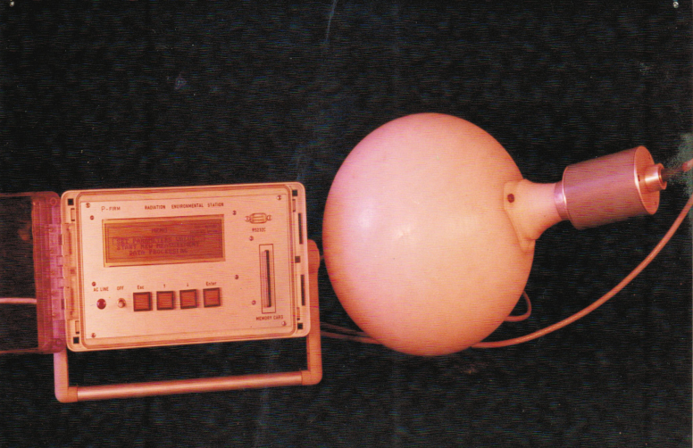
2. Instrument for low-level gamma and neutron monitoring
S. Pszona, A. Bantsar, K. Wincel. B. Zaremba
Photons in common/available neutron monitors are usually discriminated
new designed device gives possibility of registration gamma and neutron components in separate „windows”

Slide 11
2. Instrument for low-level gamma and neutron monitoring
for thermal and epithermal neutrons there is a significant contribution from secondary gamma generated by neutrons in (n,p) reactions (monte carlo calculations)
value normalized to h*(10)

Slide 12
2. Instrument for low-level gamma and neutron monitoring
Detector | Response to gammas nSv⁻¹ |  | Response to neutrons nSv⁻¹ |  | Remarks
 | Am | Cs | Cf | Am-Be
NEK 240G | 160* | 10.5 | 11.6 | 10.3 | * without Pb filter
 | 6.0 | 8.5 | 11.6 | 10.3 | with Pb filter
Almost equal response to gamma and neutrons ☺
Pb filter gives possibility to correct gamma energy dependence
Channels 125-160 gives possibility to correct response >10MeV

Slide 13
Recombination Chamber
High-pressure, tissue-equivalent ionization chamber,
operated under conditions of
initial recombination of ions
REM-2 recombination chamber
Large chamber (6 kg, 1800 cm³), 25 TE
electrodes with the diameter of 12cm;
distance between electrodes - 7 mm.
Usually filled with a mixture of methane and
nitrogen up to about 1 MPa.

Slide 14
Ion collection effciency
saturation current
i
  ionis. current
f
=
i
0
0
0
voltage
0
voltage
0

Slide 15
Dependence on radiation quality

Slide 16
Recombination index of radiation quality

Slide 17
AMBIENT DOSE EQUIVALENT*(10)
H*(10) = D*(10) x Q
Approximation within recombination methods:
H*(10) ≈ D*(10) x Q₄

Slide 18
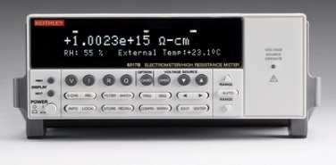
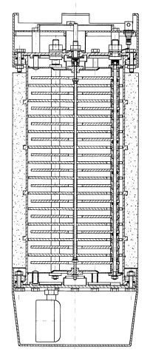
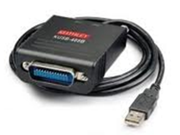
3. Monitoring system for workplaces
Keithley 6517B
Interface KUSB 448B
REM-2
Software

Slide 19
RESULTS
Rad. source | D*(10) [mSv/h] | Q₄ | H*(10) [mSv/h]
Cs-137 | 6,10E-02 | 1,00E+00 | 6,10E-02
Cf-252 + LiF | 1,10E-02 | 8,29E+00 | 9,10E-01
Cf-252 | 3,2E-02 | 8,04E+00 | 2,59E-01
Cf-252 + LiF | 1,11E-02 | 8,29E+00 | 9,14E-01
AmBe-241 | 1,54E-02 | 7,44E+00 | 1,14E-01
Cs-137 | 6,10E-02 | 1,02E+00 | 6,22E-02
Cs-137 | 6,12E-02 | 1,00E+00 | 6,12E-02
PuBe-239 | 1,53E-02 | 7,59E+00 | 1,16E-01
Cf-252 | 1,60E-02 | 8,23E+00 | 1,31E-01

Slide 20
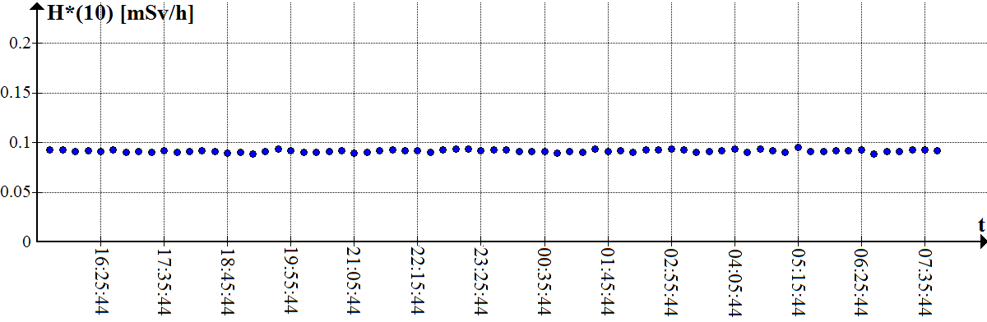
OVERNIGHT MEASUREMENTS

Slide 21
3. Monitoring system for workplaces
T

Slide 22
3. Monitoring system for workplaces
The idea of the triple-mode detector (summation mode raises sensitivity, differential mode gives possibility of direct measurements of the ambient dose equivalent rate, in case of fluctuations of dose rate. Two switches are needed for proper configuration of polarizing electrodes and for measurements of ionization current.

Slide 23

4. Ionization chamber containing ¹⁰B
M.A. Gryziński, K. Tymińska, M. Zielczyński
Development of a method for determination of ambient dose equivalent, H*(10), using an ionization chamber filled with BF₃
TARGET
  Considered solutions
    Classic recombination chamber with addition of BF₃ to the filling gas;
    High-pressure chamber filled with BF₃ and placed in external moderator;
    Relatively small chamber (BOR-2) in spherical moderator
    Air filled ionization chamber with ¹⁰B in material of electrodes

Slide 24
Ionization chamber containing ¹⁰B classic REM-2 with addition of BF₃ to the filling gas
Dose response calculated with MCNPX code (per 1 neutron)
Addition of BF₃ (about 0,1% ) improves the chamber sensitivity for low energy neutrons (<10 keV) and only slightly influences the energy dependence for fast neutrons.

Slide 25
Ionization chamber containing ¹⁰B - high pressure chamber with moderator
Thickness of the moderator, gas pressure and polarising voltage should be optimised in order to obtain similar sensitivity to H*(10) for neutrons and gamma radiation in certain energy range

Slide 26
Ionization chamber containing ¹⁰B - high pressure chamber with moderator
Moderators made with polyethylene
Angular dependence of the chamber response

Slide 27
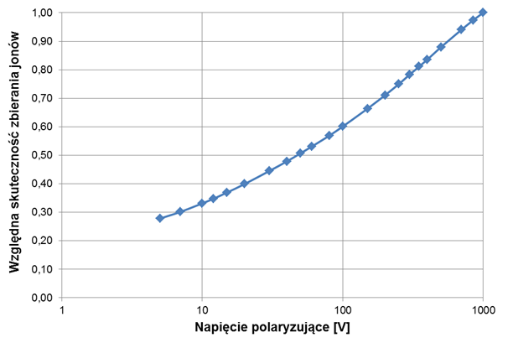
Ionization chamber containing ¹⁰B - high pressure chamber with moderator
Relative ion collection efficiency for ¹³⁷Cs and ²⁵²Cf
Saturation curves of the REM-2 chamber filled with BF₃ have been determined in neutron and gamma radiation fields.

Slide 28
Ionization chamber containing ¹⁰B high pressure chamber with moderator
  Optimum values
    Thickness of the external moderator – ca. 3 cm
    Gas pressure – 130 kPa
    Polarising voltage – 350 V for 4 cm moderator.

Slide 29
5. Model of recombination chamber with spectrometric properties
M. Zielczyński, N. Golnik, M.A. Gryziński, M. Maciak, K. Tymińska
  Considered solutions
    Number of electrodes - 21;
    Made with PP-EL
    Thickness of electrodes – 10 mm;
    Electrodes covered with B₄C
Patent application
Model. MCNPX Visual Editor

Slide 30
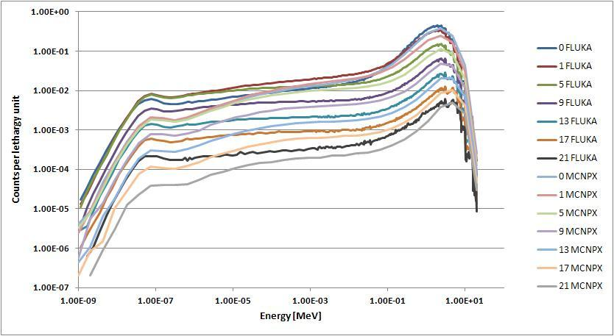
5. Model of recombination chamber with spectrometric properties
Neutron flux on the chamber lid (0) and chosen electrodes (1‐21) at 25 mg/cm3 B₄C layer thickness for both Monte Carlo codes.

Slide 31
5. Model of recombination chamber with multilayer moderator
Neutron flux on the chamber lid (0) and chosen electrodes (1‐21) at 600 mg/cm³ B₄C
layer thickness for both Monte Carlo codes.

Slide 32
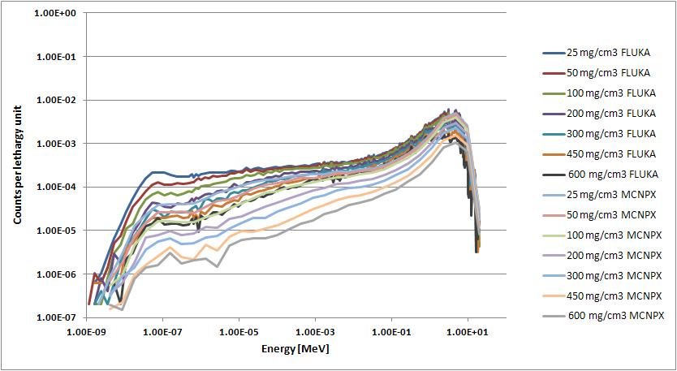
5. Model of recombination chamber with multilayer moderator
Neutron flux on the lowest electrode (21) for various values of the B₄C layer thickness for both Monte Carlo codes.

Slide 33
6. Passive detector with multilayer moderator
N. Golnik, K. Dworecki, M.A. Gryziński, P.Tulik, K. Tymińska
Radiation

Slide 34
6. Passive detector with multilayer moderator

Slide 35
6. Passive detector with multilayer moderator

Slide 37
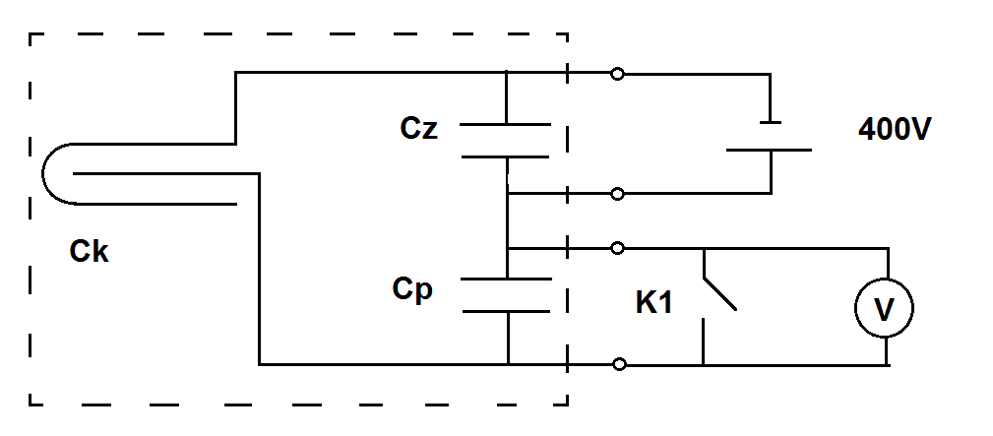
7. Accident dosimetry

Slide 38
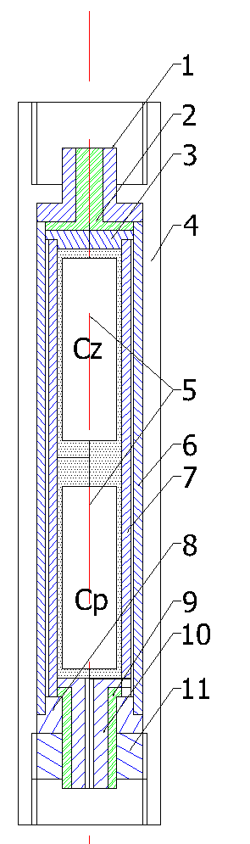
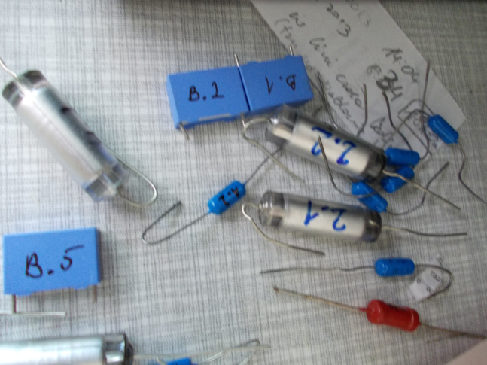
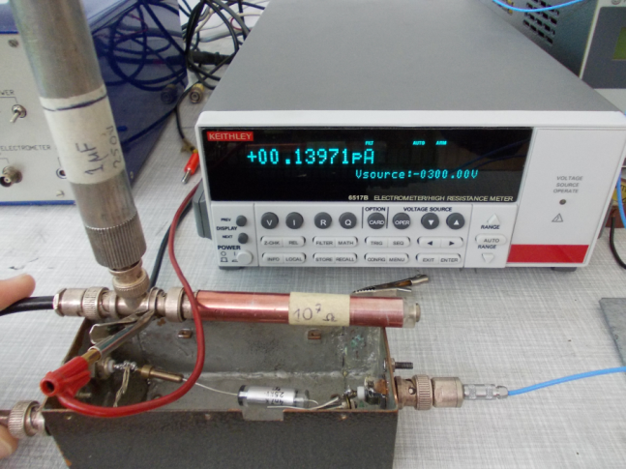
7. Accident dosimetry
Capacitors as a detector

Slide 39
THANK YOU FOR YOUR ATTENTION
WE WILL SHOW MUCH MORE IN NEXT YEAR

