Slide 1
Progress in thermoluminescence dosimetry for individual and environmental monitoring
Maciej Budzanowski, Renata Kopeć, Anna Bubak, Mariusz Kłosowski, Barbara Marczewska, Pawel Olko, Anna Sas-Bieniarz
Institute of Nuclear Physics, Kraków, Poland

Slide 2
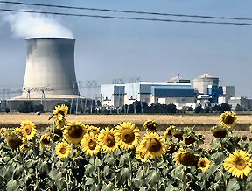
Individual and environmental dosimeter essential for operation of Nuclear Power Plant
After Chernobyl it was impossible to assess individual doses due to:
lack of individual dosemeters
too low dose range of dosimetric films

Slide 3
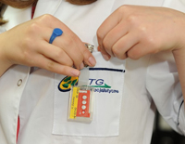
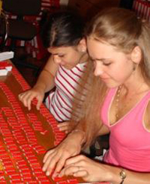
How to improve thermoluminescence dosimetry?
TLDs have very good dosimetric properties
Thermoluminescent dosimeters (TLDs) broadly used in individual and environmental monitoring (also at NPP)
Some disadvantages:
- 2nd readout not possible
- no information on static exposure
- limited dose range in accident
TLD dosimetry at LADIS Dosimetric Service at IFJ PAN

Slide 4
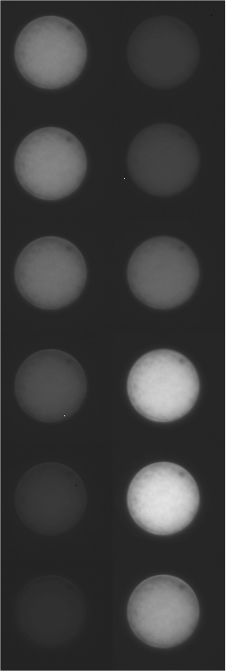
The aim of the work
To develop procedure of dose verification (second readout of TLD)
2) To get information on static exposure
3) ) To increase the dose range to 10 Gy

Slide 5
Introduction to thermoluminescence and thermoluminescent dosimetry

Slide 6
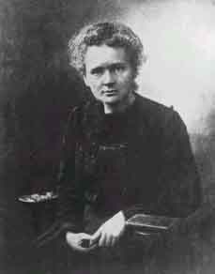
1904 – observed thermoluminescence in natural fluorite CaF₂
„....the radium source restores the thermoluminescence of fluorytu”
Maria Curie-Skłodowska

Slide 7
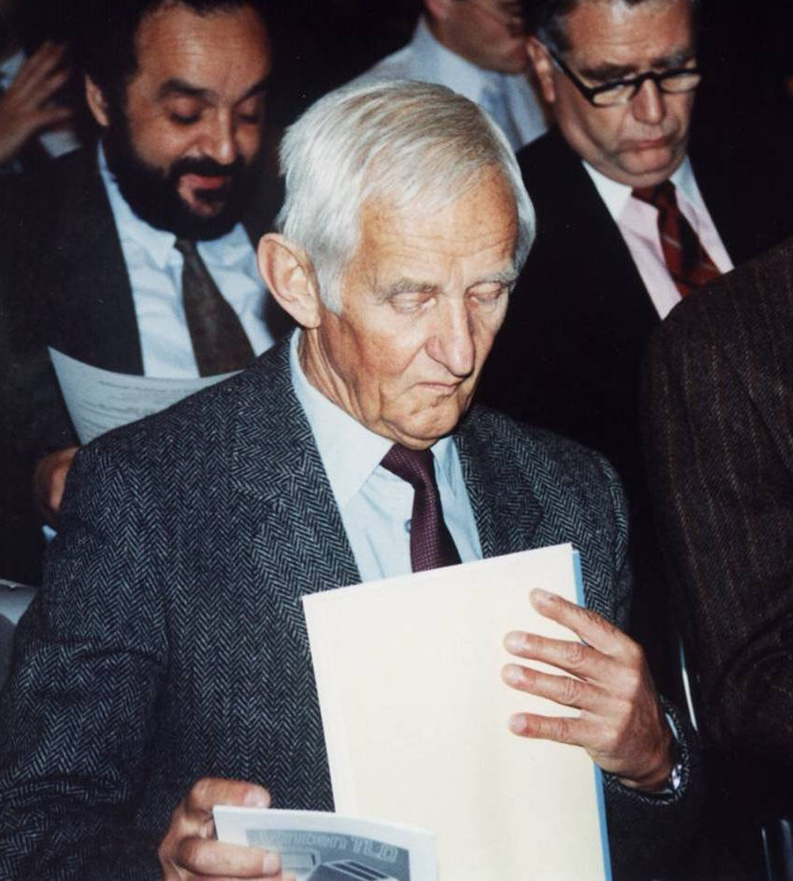
1960 First LiF monocrystals for dosimetry
1974 Patent of T. Niewiadomski LiF:Mg,Ti (MTS-N)
1978 Licence for Studsvik for MTS-N
1983 Thin layer CaSO₄:Dy for radon dosimetry
1985 High sensitive MCP-N (LiF:Mg,Cu,P)
1995 Thin layer MCP-Ns
2005 MTT (LiF:Mg,Ti) for space measurements kosmosie
2005 Detektory powierzchniowe 2-D do pomiarów klinicznych
Tadeusz Niewiadomski, Institute of Nuclear Physics , Kraków, Poland (1920-1996)

Slide 8
Model of luminescence - excitation
Yukihara, SSD 15, 2007

Slide 9
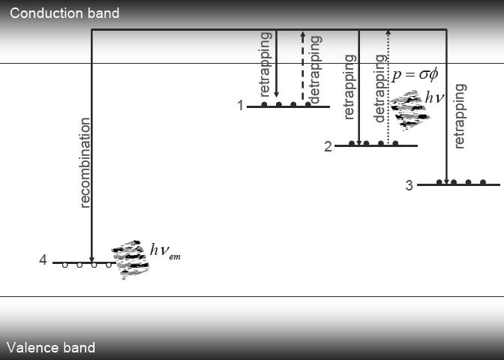
Model of luminescence - stimulation
Luminescence
Heat
Yukihara, SSD 15, 2007

Slide 10
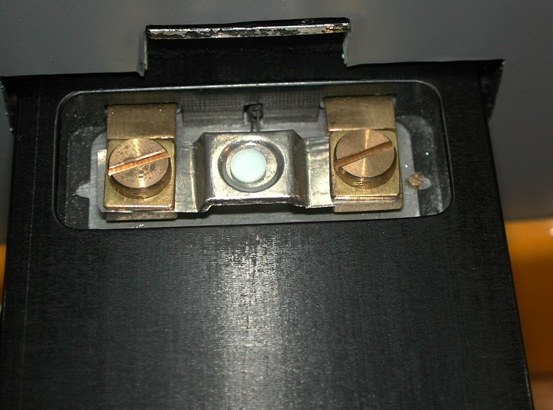
Thermoluminescence – 2 stage process
Ionisation and trapping holes and electrons in trapping centers
Notes:
You know the priciple of thermoluminescence
Ionising radiation, interacting with TL detectors, produces ionisa

Slide 11
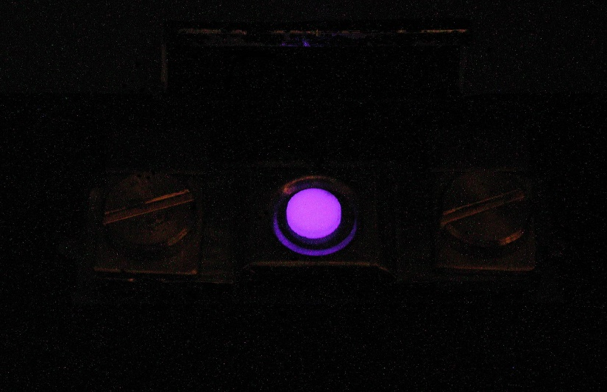
Thermoluminescence – 2 stage process
Photomultiplier
Ionisation and trapping holes and electrons in trapping centers
Notes:
You know the priciple of thermoluminescence
Ionising radiation, interacting with TL detectors, produces ionisa

Slide 12

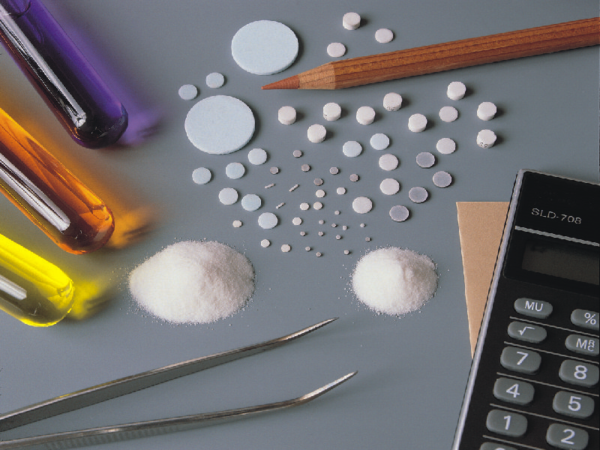
What do we need ? TL detectors
LiF:Mg,Ti LiF:Mg,Cu,P CaSO₄:Dy

Slide 13
What do we need ? TL readers
PM
CCD
High –sensitive
CCD camera

Slide 14
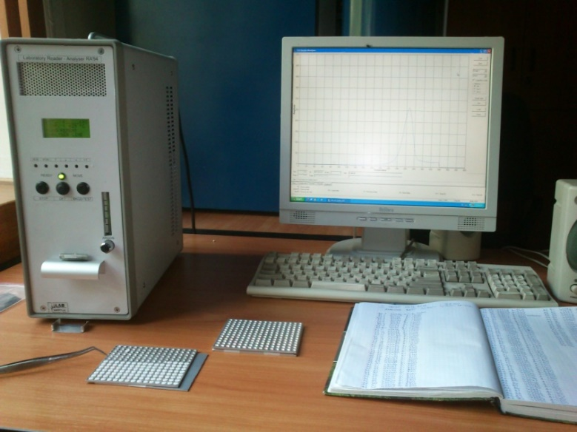
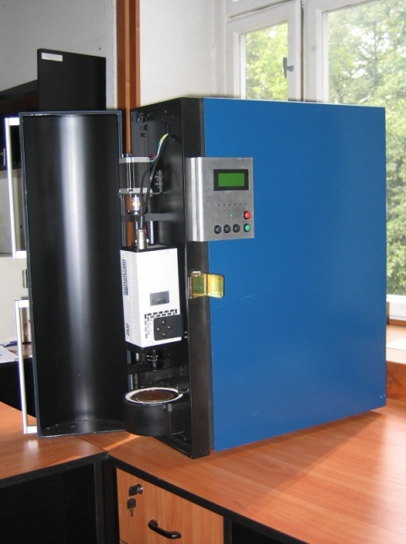
What do we need ? TL readers
Manual RA-94 TLD reader (Mikrolab, Kraków)
Experimental 2D TLD reader with CCD camera, IFJ PAN Kraków
Notes:
You know the priciple of thermoluminescence
Ionising radiation, interacting with TL detectors, produces ionisa

Slide 15
Result of readout : TL glow curve

Slide 16
Second readout of TL detectors for re-estimation of dose

Slide 17
Phenomenon of luminescence
conduction
band
conduction
band
radiation
TL light
valence
band
valence
band

Slide 18
Normal readout of TL detector (LiF:Mg,Ti)
MTS-N ( LiF:Mg,Ti) detectors, 50 mGy

Slide 19
UV light on irradiated TL detector
UV radiation
conducting
band
conducting band
TL light
valence
band
valence
band

Slide 20
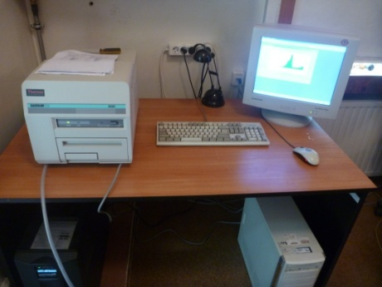
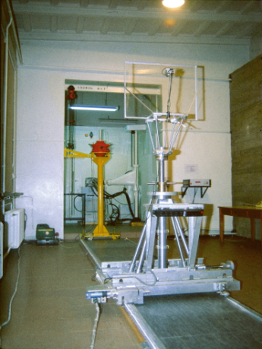
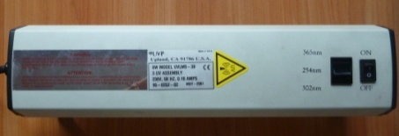
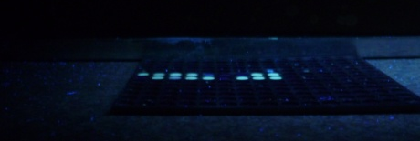
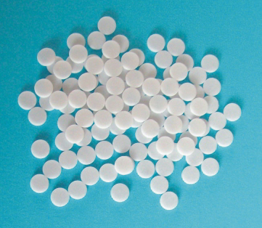
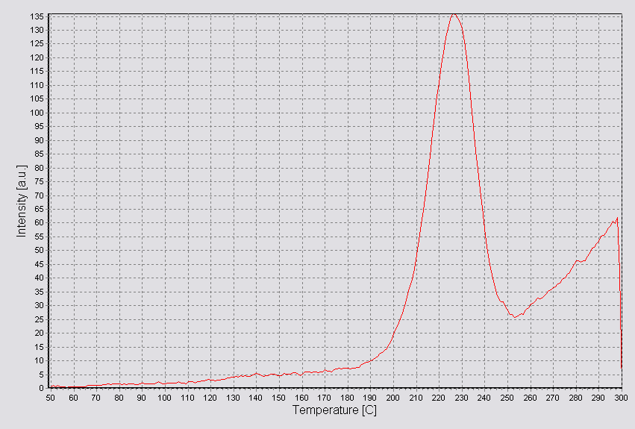
The method of work
Irradiation (γ)
Readout
UV exposure
2nd readout

Slide 21
2nd readout after UV irradiation of detector (LiF:Mg,Ti)

Slide 22
MTS-N ( LiF:Mg,Ti) detectors glow curves after the 20 mGy irradition.
1st readout – normal 2nd readout - after UV irradiation

Slide 23
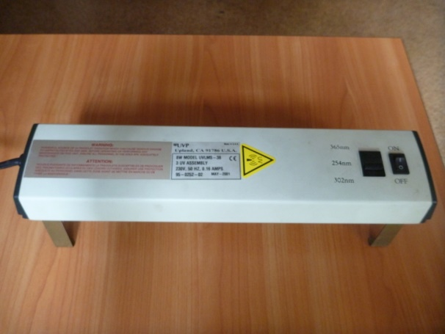
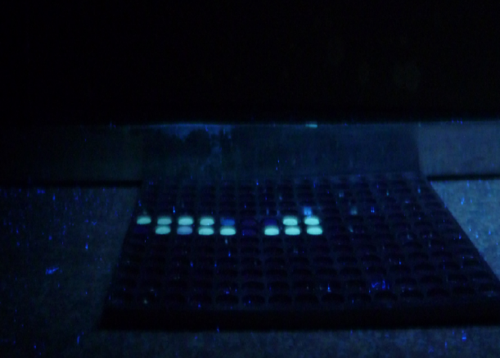
Optmalization of 2nd readout: UV exposure
Detector type
UV wavelenght
  - 254 nm
  - 302 nm
  - 365 nm
Exposure time
Background correction

Slide 24
Optmalization of 2nd readout: UV wavelenght
MTS-N ( LiF:Mg,Ti) detectors glow curves after the 20 mGy irradition.
2nd readout - after UV irradiation 254 nm optimal

Slide 25
Optmalization 2nd readou: time of UV exposure
Optimal irradiation time: 1.5 hours

Slide 26

Optmalization of 2nd readout : temperaturę of UV exposure
Optimal irradiation temperature : 80 C

Slide 27
Optmalization of 2nd readout: dose response

Slide 28
Optmalization of 2nd readout : background corection
10 mGy
50 mGy

Slide 29
Optimization of 2nd readout: summary
The re-estimation of dose can be performed with precision better than 10% for doses exceeding 10 mSv.
The method works for LiF:Mg,Ti detectors but not for high sensitive MCP-N (LiF;Mg,Cu,P).
The method is ready for use. It will be implemented at IFJ PAN - LADIS laboratory in Kraków, as a first in the world.

Slide 30
Evaluation of doses up to 10 Gy

Slide 31
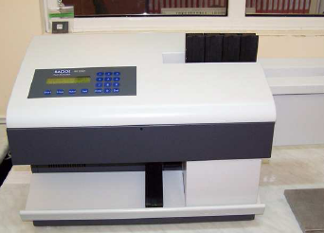
The problem
In individual dosimetry readers optimized for low doses
If D > 1 Sv appears then high probability of saturation of individual dosemeter
The aim of the work
To investigate, calibrate and test the system from low doses to 10 Gy
RE-2000 TLD Reader

Slide 32
TL glow curves after high doses of gamma-rays
LiF:Mg,Ti
1 Gy
10 Gy
LiF:Mg,Ti
LiF:Mg,Cu,P
1 Gy
10 Gy
LiF:Mg,Cu,P

Slide 33
Przykład zastosowania dodatkowego filtra podczas odczytu dawek 10 Gy
Dla detektorów MTS-N (góra) i MCP-N (dół)
10 Gy
LiF:Mg,Ti
10 Gy
LiF:Mg,Cu,P
Installation of grey filter to reduce the emission intensity

Slide 34
Readout with additional filter
10 Gy
LiF:Mg,Ti
10 Gy
LiF:Mg,Cu,P

Slide 35
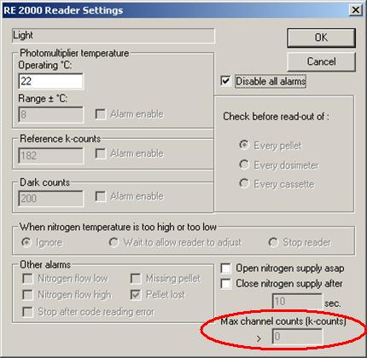
Method
After exceeding the max. channel count
STOP
INTRODUCE FILTER
DETECTORS 2,3,4 measured with the filter

Slide 36
Results for MTS-N (LiF;Mg,Ti) detectors
supralinearity

Slide 37
Results for MCP-N (LiF:Mg,Cu,P) detectors

Slide 38
Identification of static exposure

Slide 39
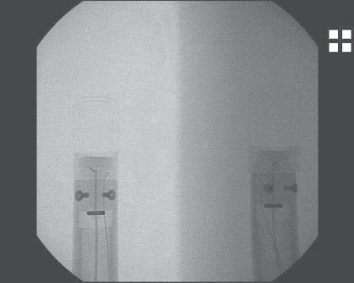
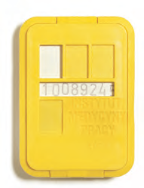
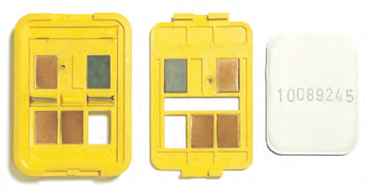
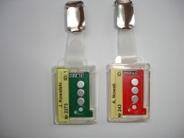
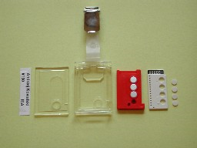
What is static and dynamic exposure?
Films
(IMP Łodzi, Poland
TLDs
Film exposed to static and dynamic exposure.
TLD curve
TLD (IFJ PAN Krakow)

Slide 40
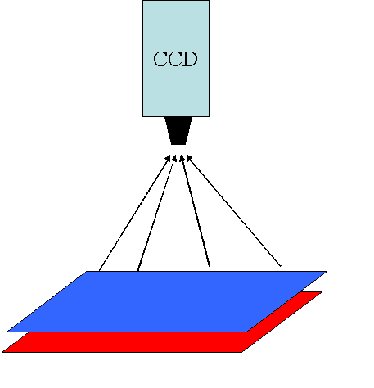
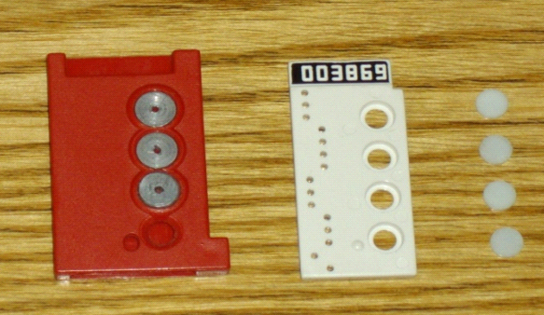

Method

Slide 41
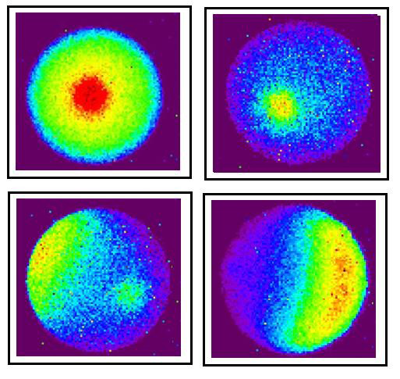
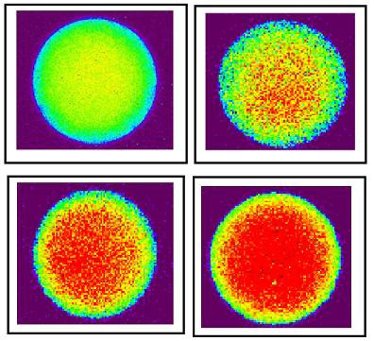
Results for X-rays
D= 20 mSv; static exposure
under Oº, 30º, 45º, 60º.
Dose 5 mSv, 10 mSv, 15 mSv i 20 mSv; dynamic exposure
40 kVp X-rays

Slide 42
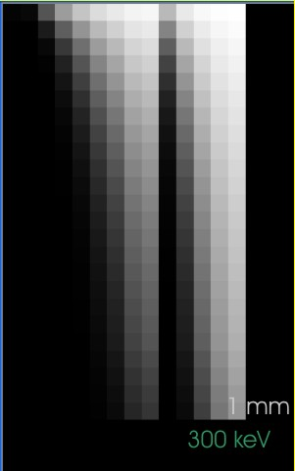
The problem
In nuclear industry exposure takes place at higher photon energies
In LADIS dosimetric service the highest exposures measured regularly for Cs-137 sources.
For 661 keV thicker filters and more sensitive cameras needed
Filter thickness
Photon Energy

Slide 43
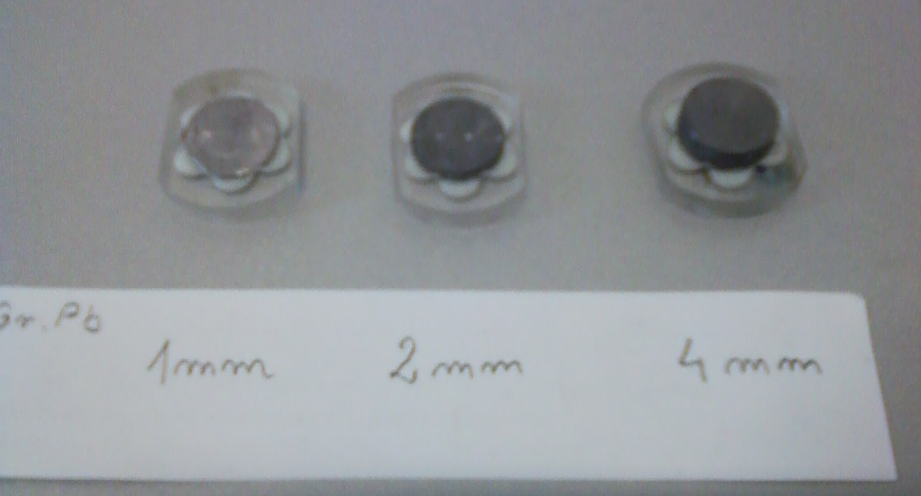
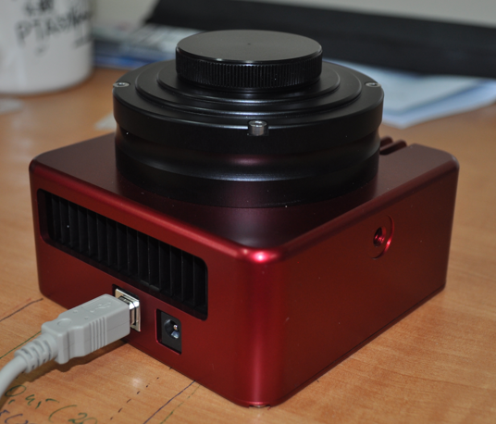
Preliminary setup
New CCD camera
MCP-N detectors covered with 1 mm, 2 mm and 4 mm Pb filters

Slide 44
Preliminary results
Pb thickness | Detector No. | TL without Pb | TL under Pb | Difference
1 mm | R88-1 | 266 | 258 | 8
 | R88-2 | 267 | 261 | 6
 | R88-3 | 268 | 260 | 8
 | R89-1 | 274 | 266 | 8
 | R89-2 | 273 | 265 | 8
 | R89-3 | 273 | 266 | 7
2 mm | R90-1 | 253 | 244 | 9
 | R90-2 | 248 | 239 | 9
 | R90-3 | 247 | 238 | 9
 | R94-1 | 255 | 245 | 10
 | R94-2 | 257 | 248 | 9
 | R94-3 | 261 | 252 | 9
4 mm | R95-1 | 238 | 219 | 19
 | R95-2 | 232 | 217 | 15
 | R95-3 | 239 | 223 | 16
 | R96-1 | 244 | 223 | 21
 | R96-2 | 232 | 214 | 18
 | R96-3 | 239 | 222 | 17

Slide 45
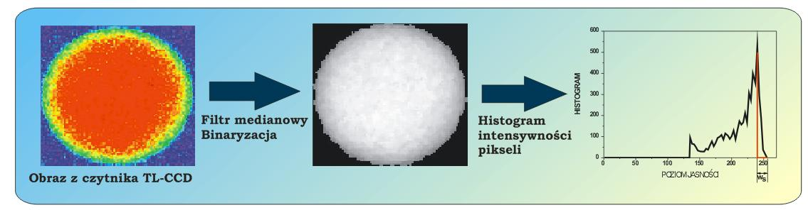
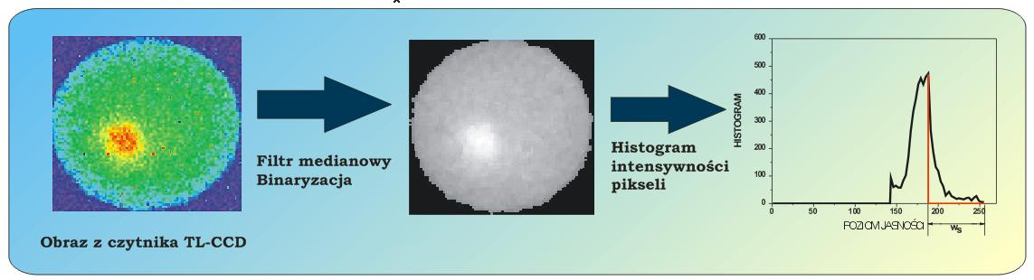
Method of analysis – histogram of pixel intensity

Slide 46
Summary and conclusions
New method for re-estimation of dose for thermoluminescence detectors LiF:Mg,Ti js been developed. Second readout after 1.5 h UV irradiation allows to determine doses above 5 mSv.
The dose range for individual dosemeter has been extended to 10 Gy, allowing for using it in accidental exposures
The preliminary tests demenstrate that it is possible to distinguish statiic exposure of TLD detectors for 661 keV gamma-rays

Slide 47
This research was kindly supported from the project
DEVELOPMENT OF NUCLEAR SAFETY AND RADIOLOGICAL PROTECTION METHODS
FOR THE NUCLEAR POWER ENGINEERING’S CURRENT AND FUTURE NEEDS
from
Narodowe Centrum Badan i Rozwoju, NCBiR

