Slide 1

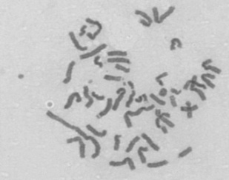
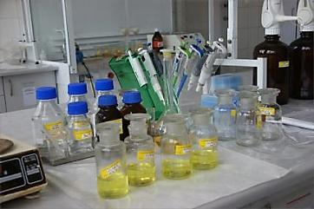
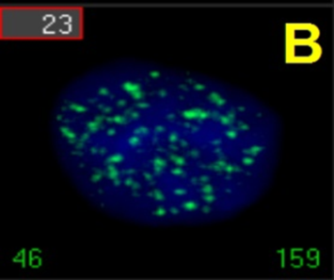
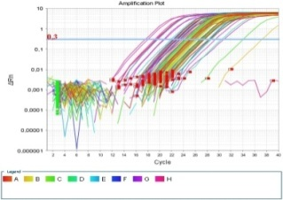
Classical and modern methods in biological dosimetry
Kamil Brzóska
Institute of Nuclear Chemistry and Technology,
Centre for Radiobiology and Biological Dosimetry, Warsaw, Poland

Slide 2
What is biological dosimetry?
Biological dosimetry is the quantification of exposure to ionising radiation by means of the measurable biological changes that take place in the system (biological indicators).
Based on such indicators an individual’s exposure to ionising radiation can be detected and possible consequences of the exposure can be predicted.
It enables suitable medical treatment to be planned when information from physical dosimetry is not available.

Slide 3
When can biological dosimetry be used?
• When physical dosimetry information is not available as in the case of many accidents;
• When the dosimetric information derived from physical dose meter is unreliable (e.g., non-uniform exposures);
• Independently assess the damage as and when required for implementation of radiation protection standards;
• To confirm suspected cases of overexposure;
• Assessment of response in radiotherapy patients;
• To check the compliance of dose limits for occupational exposures.

Slide 4
Characteristics of the ideal biological dosimeter
• Should be sensitive in a wide dose range (20 mGy to several Gy);
• Should show a reproducible dose response;
• Should be a radiation specific;
• Changes must occur early but remain stable for long time;
• Should respond to all types of radiation (Low/high LET);
• Partial body irradiations must be detectable and should enable the part exposed to be identified;
• The technique should be as low invasive as possible;
• It should be rapid and simple;
• The technique should be amenable to automation.

Slide 5
Biological dosimetry assays
Blood cells counts;
Dicentric chromosomal aberration analysis;
Micronucleus assay;
Premature Chromosome Condensation (PCC);
Assay of stable aberrations using Fluorescent in Situ Hybridization (FISH);
Histone γ-H2AX foci formation assay;
Gene expression analysis;
Electron Spin Resonance (ESR) of dental enamel;
skin speckle assay based on radiation-induced optical changes of skin;

Slide 6
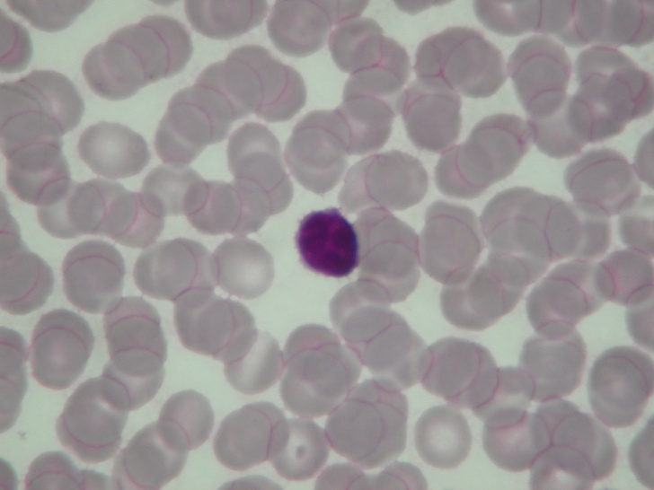
Most biological dosimetry methods use peripheral blood lymphocytes
Blood sampling is a low-invasive procedure;
Lymphocytes circulate through the body and therefore even when only a part of the body was irradiated the dosimetry is possible;
They are synchronized and easy to culture.
Peripheral human lymphocytes

Slide 7
Dicentric assay is a „gold standard” for biological dosimetry
Signal is detectable in lymphocytes, hence suitable even for partial body exposure;
Dicentrics are specific for radiation, their spontaneous frequency is very low in the healthy general population (about one dicentric per 1000 cells);
The frequency of dicentrics slowly decreases with time;
Realistic minimal detection level is about 0.2 Gy of whole body irradiation;
Maximum detection level is 5-8 Gy;
The method is reliable and most frequently used.

Slide 8
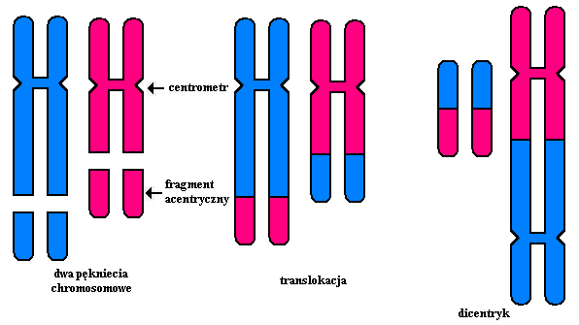
Mechanism of dicentric formation
centromere
acentric
fragment
chromosomal breaks
translocation
dicentric

Slide 9
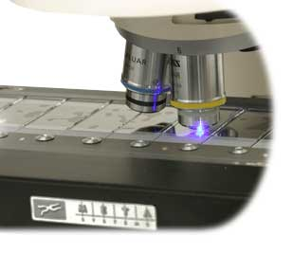
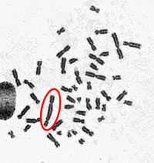
Dicentric assay
centromers

Slide 10
Dicentircs dose-response curve for gamma Co60 radiation
Dicentrics/100 mitotic cells
Dose (Gy)

Slide 11
Disadvantages of the dicentric assay
Dicentric assay is time consuming and laborious, therefore not suitable for mass casualties scenarios;
The level of dicentrics in lymphocytes decreases with time, thus the retrospective dosimetry is unreliable;
To reveal dicentrics, lymphocytes must be induced to cell division using mitogen (e.g., phytohaemagglutinin) and cultured for 48 h before scoring can begin.

Slide 12
Objective 2: Development of biological dosimetry methods
Phase 10: Evaluation of the relevance of combined PCC and FISH methods for biological dosimetry

Slide 13
Premature Chromosome Condensation (PCC) Assay
To visualize the alterations in DNA, chromosomes are artificially condensed using phosphatases inhibitors calyculin A or okadeic acid;
The method works only in the cycling cells, therefore lymphocytes have to be stimulated by phytohaemagglutinin (PHA);
Morphological changes such as: additional PCC fragments, PCC rings, dicentrics, translocations and unusually long chromosomes can be seen in G2/M cells (after 48h);
PCC method is usually used after very high doses of radiation, when the dicentric assay fails, because of cells stopped in cell cycle checkpoint G2/M;

Slide 14
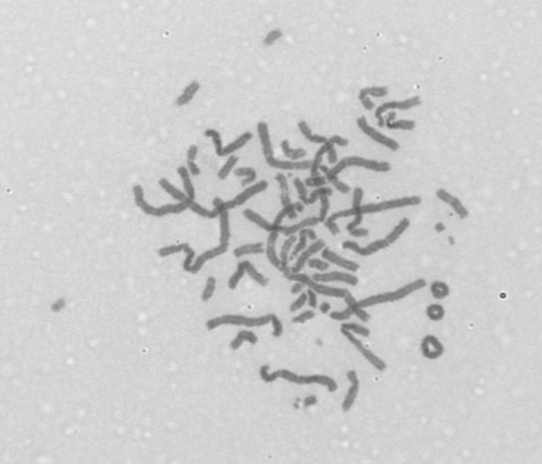
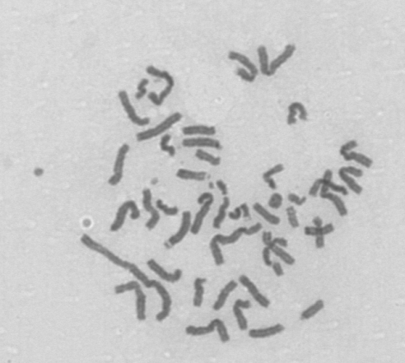
Chemically induced PCC after high doses of radiation
Unusually long chromosomes
PCC rings

Slide 15
RICA - The Rapid Interphase Chromosome Assay

Slide 16
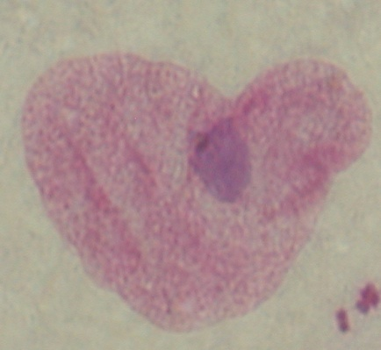

RICA combines two methods
Chemically induced PCC in human lymphocytes in G₀ phase of cell cycle
Chromosome territories painting by FISH (Fluorescence In Situ Hybridisation)
+
Okadeic acid or calyculin A + ATP and CDK1

Slide 17
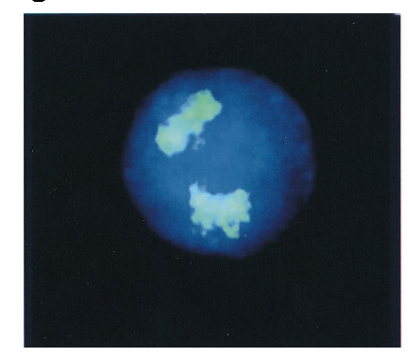
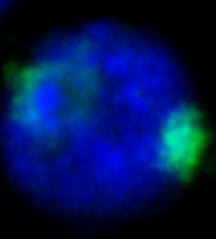
with PCC
without PCC
non-irradiated
irradiated
Prasanna et al. Mutation Research 466 (2000) 131-141

Slide 18
The advantages of RICA technique
It can be performed in unstimulated lymphocytes and therefore is faster than classical PCC, or dicentric assay;
High number of available cells;
It can be automated.

Slide 19
Results:
Two phosphatases inhibitors have already been tested: okadaic acid and calyculin A. Better results were obtain with okadeic acid, but still the number of condensed cells are to low to make any reasonable analysis;
In parallel to RICA we are validating classical chemically (calyculin A) induced PCC in G2/M lymphocytes;
Work in progress: creating the calibration curves in classical PCC for: PCC additional fragments, PCC rings and PCC unusually long chromosomes.

Slide 20
Objective 2: Development of biological dosimetry methods
Phase 9: Evaluation of the relevance of gene expression analysis in blood cells for biological dosimetry

Slide 21
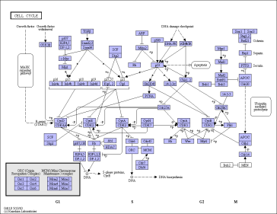
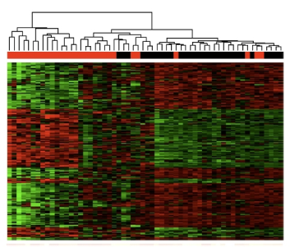

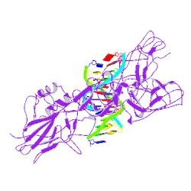
Gene expression in blood cells as a potential biological dosimeter
Damage to macromolecules (DNA, proteins)
Modification of activity of the cellular signaling pathways
Changes in gene expression
irradiation

Slide 22
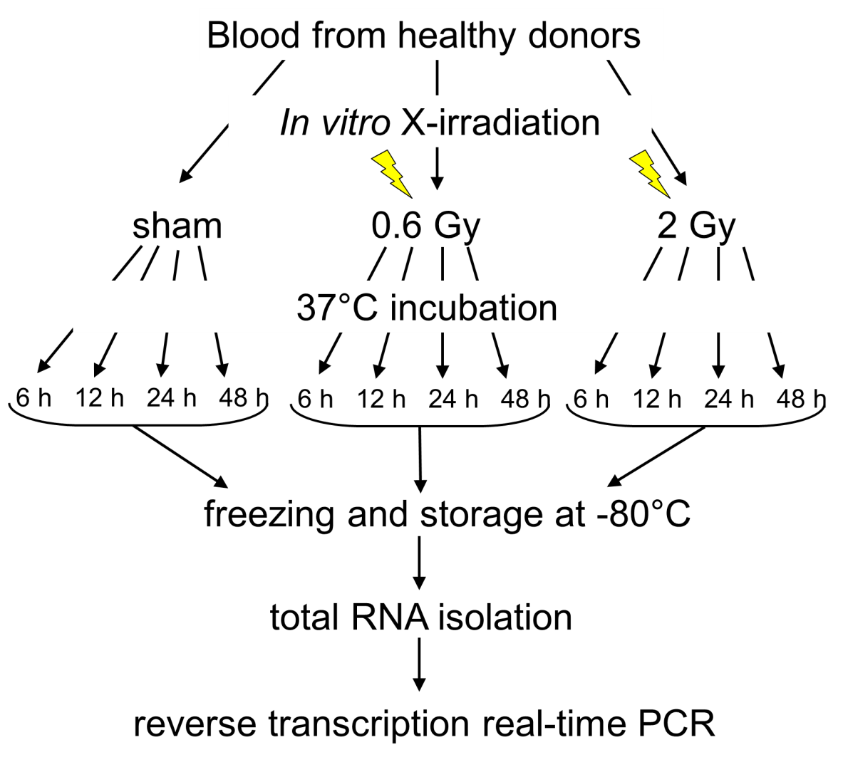
Schematic representation of the experiment

Slide 23
Examples of the analyzed genes
Related to the DNA damage response: GADD45A, MDM2, DDB2;
Cell cycle control: CDKN1A, PLK3;
Programmed cell death (apoptosis): BAX, BCL2, BBC3;
Cellular response to stress: ATF3, SESN2, GDF15, FDXR;
Inflammatory response: TNFSF4;

Slide 24
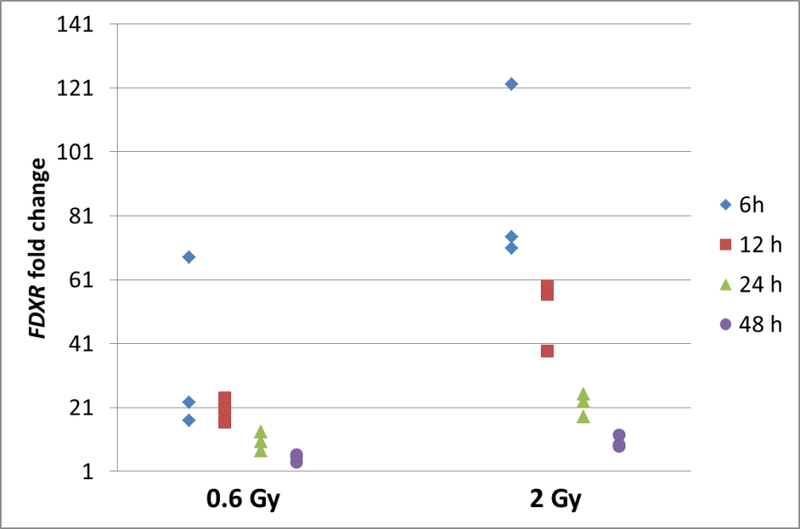
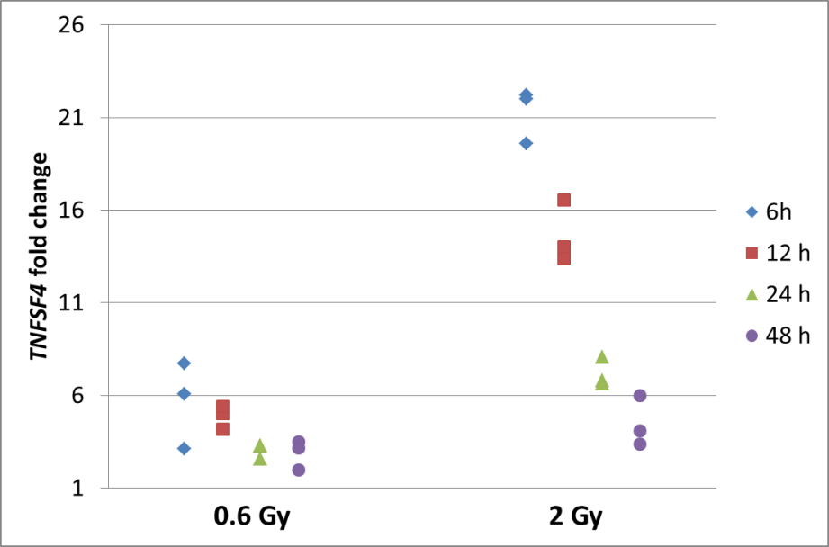
Gene expression results (1)
FDXR
TNFSF4
Examples of genes highly but transiently induced after irradiation.

Slide 25
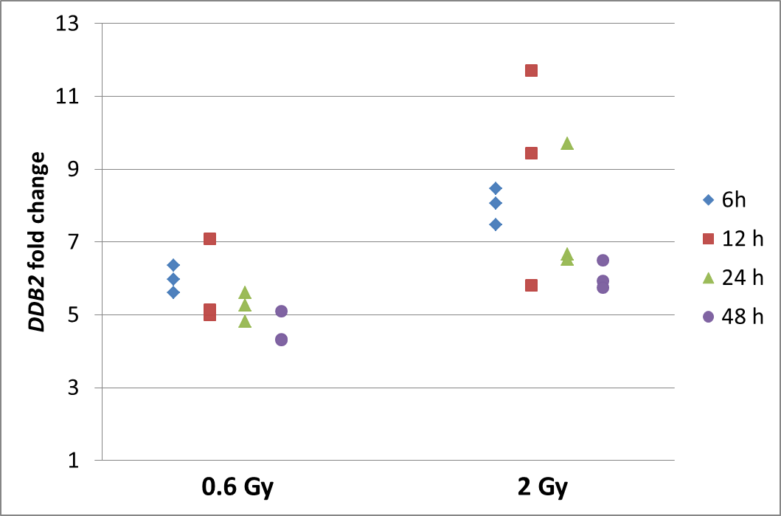
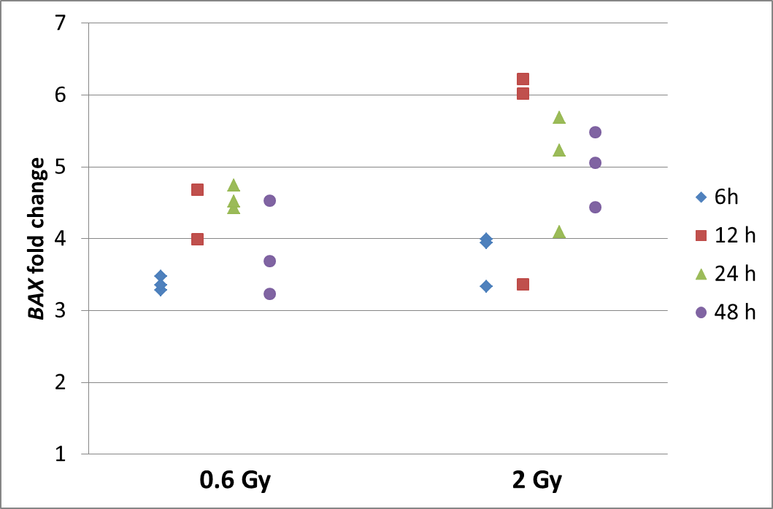
Gene expression results (2)
DDB2
BAX
Genes with stably increased expression even 48 h after irradiation

Slide 26
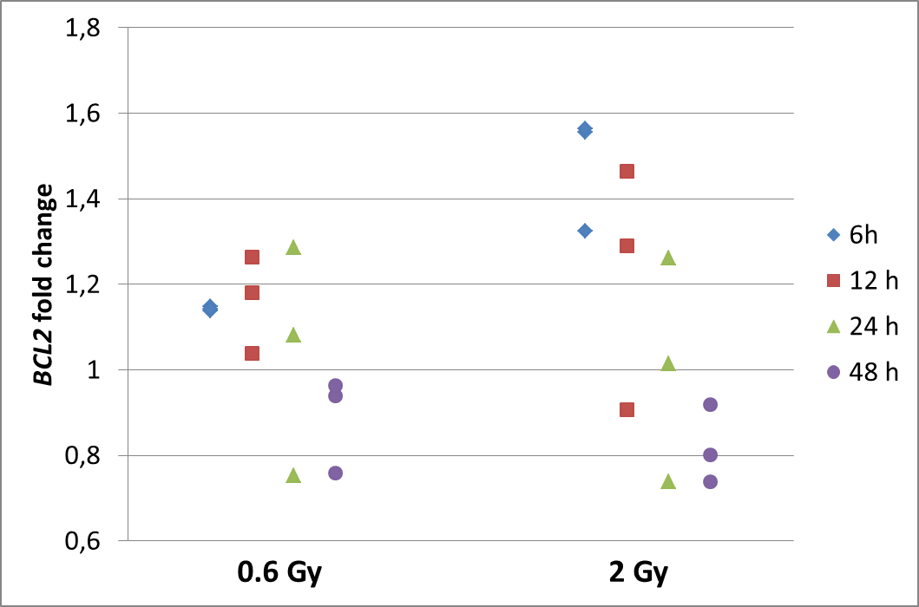
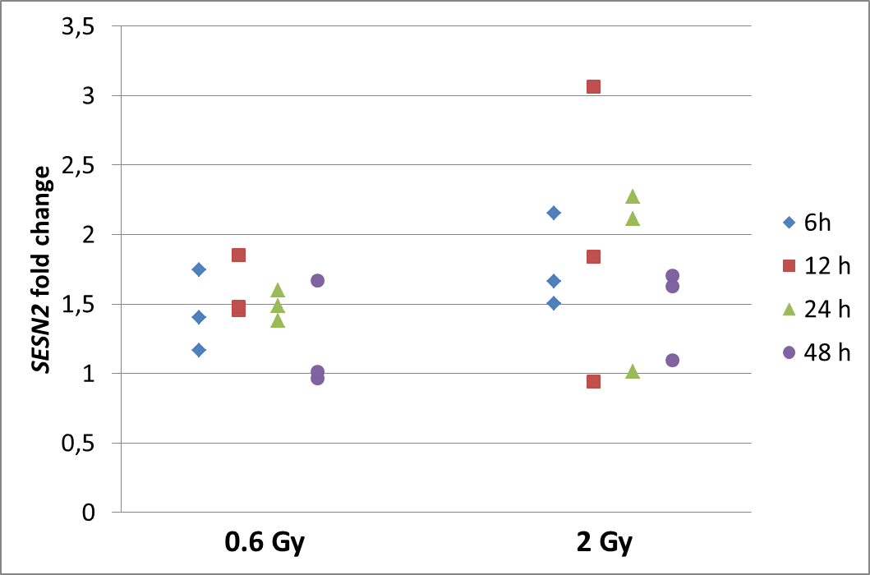
Gene expression results (3)
BCL2
SESN2
Genes that didn’t prove to be deregulated by irradiation and therefore are not suitable for biological dosimetry.

Slide 27
Preliminary conclusions from the gene expression analyses
Time after irradiation is the crucial factor in the analysis;
It is possible to identify irradiated samples;
Accurate dose prediction is difficult;
Interindividual variability is significant and must be taken into account.

Slide 28
Thank You for attention
Prof. Marcin Kruszewski
Prof. Anna Lankoff
Dr Sylwester Sommer
Dr Kamil Brzóska
Dr Maria Wojewódzka
Dr Teresa Bartłomiejczyk
Iwona Buraczewska
Tomasz Stępkowski
Institute of Nuclear Chemistry and Technology,
Centre for Radiobiology and Biological Dosimetry, Warsaw, Poland

