Slide 1
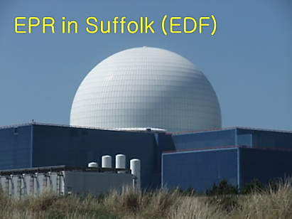
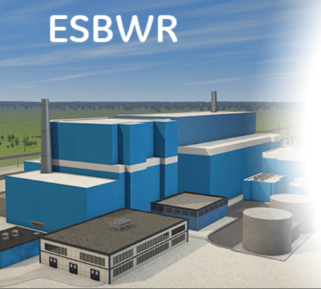
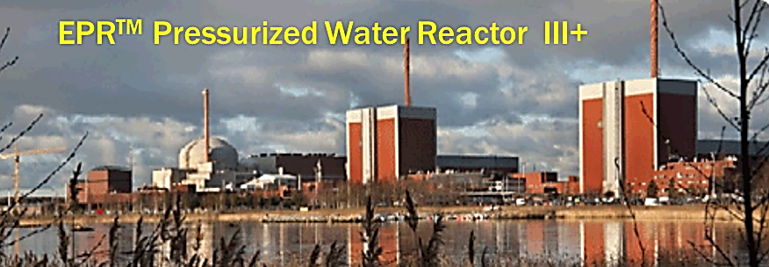
OVERVIEW THE PROJECT OBJECTIVES
AND
MAJOR ACHIEVEMENTS
PAWEŁ KRAJEWSKI
CENTRAL LABORATORY FOR RADIOLOGICAL PROTECTION

Slide 2
BACKGROUND INFORMATION
Nuclear Power Programme implementation is the vital part of the strategic documents of the Country, including
 |  | Long term Development Strategy ”Poland 2030. Third wave of modernity”
 |  | Medium term Development Strategy - ”Country’s Development Strategy 2020”
 |  | Integrated sectorial strategies:
 |  | Energy Safety and Environment Strategy
 |  | Innovative Economy Strategy
These strategies are based on the Law of December 6th, 2006 on the principles of conducting the development policy

Slide 3
BACKGROUND INFORMATION
In all relevant documents adopted by the government of the Republic of Poland the needs of nuclear safety are recognized:
 |  | Resolution no. 4/2009 of the Council of the Ministers of 13 January 2009 on nuclear power development activities
 |  | Ordinance of the Government of 12 May 2009 on establishing the Government Commissioner for Nuclear Power in Poland
 |  | Resolution of the Government of 11 August 2009 on “Framework time schedule for nuclear power activities”
 |  | Resolution of the Government of 10 November 2009 on approval of the National Energy Policy up to 2030
 |  | Resolution of the Government of 25 January 2010 adopting the draft of the PNPP
 |  | Law of May 13th, 2011 on amendment of Atomic Law and other laws - entered into force on 2011.07.01
 |  | Law of June 29th, 2011 on preparation and realization of Investments in nuclear facilities and accompanying investments - entered into force on 2011.07.01

Slide 4
BACKGROUND INFORMATION
Polish Nuclear Power Programme PNPP - will be approved in the second half of 2013 by the Government
 |  | The transborder consultations of the PNPP – accomplished in the end of 2012
 |  | Prognosis of the Strategic Environmental Impact Assessment completed in 2012
Nuclear Energy Programme Implementing Organisation (NEPIO)
 |  | established and staffed in March 2009
Committee for the Polish Nuclear Power
 |  | appointed by the Regulation No 70 of the Prime Minister of 9 September 2009

Slide 5
BACKGROUND INFORMATION
Polish Nuclear Power Programme PNPP
 |  | reflects all issues of the Milestones document
 |  | is based on INIR guidance documents (including the 2009 guidance on INIR missions)
 |  | covers the time tables for preparatory activities as well as the investors’ activities connected with the construction of the first unit of the NPP

Slide 6
BACKGROUND INFORMATION
Nuclear Safety
 |  | On July 1st, 2011 the Law of May 13th, 2011 on amendment of Atomic Law and other laws entered into force. Most chapters of the amended Atomic Law concern nuclear safety from the viewpoint of various stakeholders – public, environment, regulator, investor, operator, employees, state administration etc.
 |  | Importantly, the Atomic Law implements the following directives and regulations of the European Union (connected directly or indirectly with nuclear safety, security and radiological protection):
 |  | Council Directive 89/618/Euratom of 27 November 1989 on informing the general public about health protection measures to be applied and steps to be taken in the event of a radiological emergency. | Council Directive 97/43/Euratom of 30 June 1997 on health protection of individuals against the dangers of ionizing radiation in relation to medical exposure, and repealing Directive 84/466/Euratom .
 |  | Council Directive 90/641/Euratom of 4 December 1990 on the operational protection of outside workers exposed to the risk of ionizing radiation during their activities in controlled areas. | Council Directive 2003/122/Euratom of 22 December 2003 on the control of high-activity sealed radioactive sources and orphan sources
 |  | Council Directive 96/29/Euratom of 13 May 1996 laying down basic safety standards for the protection of the health of workers and the general public against the dangers arising from ionizing radiation | Council Directive 2006/117/EURATOM of 20 November 2006 on the supervision and control of shipments of radioactive waste and spent fuel
 |  | Council Directive 2009/71/EURATOM of 25 June 2009 establishing Community framework for the nuclear safety of nuclear installations

Slide 7
STRATEGIC RESEARCH AND DEVELOPMENT PROGRAMMES
Nuclear Power Programme also implies a significant development of Polish research units involved in atomic energy science and technology development
 |  | The great importance for scientific research and contributions in the area of nuclear safety and radiological protection has a new program of The National Centre for Research and Development (NCBiR) entitled:
 |  | “Technologies Supporting Development of Safe Nuclear Power Engineering”

Slide 8
8
Technologies Supporting Development of Safe Nuclear Power Engineering
The Project comprises the following research tasks:
1 | Development of high temperature reactors for industrial purposes (research network leader Academy of Mining and Metallurgy in Krakow)
2 | Research and development of technology for controlled thermonuclear fusion (consortium leader – Henryk Niewodniczański Institute of Nuclear Physics, Polish Academy of Sciences)
3 | Meeting the Polish nuclear power engineering’s demand for fuel – fundamental aspects (research network leader – University of Warsaw)
4 | Development of spent nuclear fuel and radioactive waste management techniques and technologies (contractor – Institute of Chemistry and Nuclear Technology)
5 | Study of possibilities and criteria for participation of the Polish industry in the worldwide expansion of nuclear power engineering (research network leader – Warsaw University of Technology)

Slide 9
9
Technologies Supporting Development of Safe Nuclear Power Engineering
The Project comprises the following research tasks cont:
6 | Development of nuclear safety and radiological protection methods for the nuclear power engineering’s current and future needs (research network leader – Central Laboratory for Radiological Protection)
7 | Study of hydrogen generation processes in nuclear reactors under regular operation conditions and in emergency cases, with suggested actions aimed at upgrade of nuclear safety (contractor – Institute of Chemistry and Nuclear Technology);
8 | Study of processes occurring under regular operation of water circulation systems in nuclear power plants with suggested actions aimed at upgrade of nuclear safety (contractor – Institute of Chemistry and Nuclear Technology);
9 | Development of methods and performance of safety analyses in nuclear reactors with heat reception disturbances under critical failure conditions (research network leader – Warsaw University of Technology, The faculty of Power and Aeronautical Engineering);
10 | Development of a method and performance of an exemplary systemic analysis of the operation of a nuclear plant with a water reactor under partial association conditions (Gdansk University of Technology, Faculty of Electrical and Control Engineering)

Slide 10
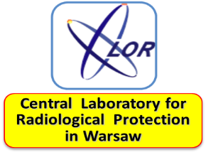
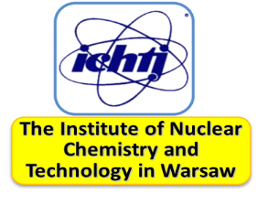
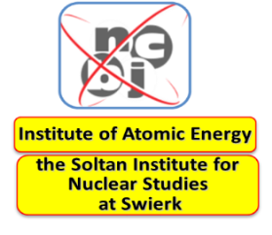
10
Management and decision-making structures of the project
Leader
Dr P. Krajewski
CLOR
Financial and planning team
CEL 1
Dr P. Krajewski
CLOR
CEL 2
Prof. dr hab. M. Kruszewski
ICHTJ
CEL 3
Prof. dr hab. Paweł Olko
IFJ
CEL 4
Prof. dr hab. N. Golnik
NCBJ
ETAP 1: Mgr K. Ciupek (CLOR)
ETAP 3: Prof. dr hab. I. Śliwka (IFJ)
ETAP 2: Dr K. Kozak (IFJ)
ETAP 4: Mgr inż. T. Pliszczyński (NCBJ)
ETAP 5: Dr hab. H.Polkowska-Motrenko (ICHTJ)
ETAP 6: Prof. dr hab. A. Lankoff (ICHTJ)
ETAP 7: Prof. dr hab. A. Cebulska-Wasilewska (IFJ)
ETAP 8: Dr M. Kowalska (CLOR)
ETAP 9: Prof. dr hab. M. Kruszewski (ICHTJ)
ETAP 10: Dr S. Sommer (ICHTJ)
ETAP 11: Dr inż. M. Budzanowski (IFJ)
ETAP 13: Dr inż. M. Gryziński (NCBJ)
ETAP 14: Mgr K. Szewczak (CLOR)
ETAP 12: Dr inż. J. Ośko (NCBJ)
ETAP 15: Mgr inż. K. Isajenko (CLOR)
ETAP 16: Dr hab. J.W. Mietelski (IFJ)
ETAP 17: Dr inż. P. Tulik (NCBJ)
ETAP 18: Dr inż. S. Pszona (NCBJ)
Steering Commitee

Slide 11
11
Objectives and scope of the project
FOUR KEY THEMATIC BLOCKS
 |  | General concept and methodology for a baseline of environmental conditions in foreseen location of NPP
 |  | Pilot studies in selected locations (September 2013) subject of WorleyParsons & PGE (investor – future operator) negotiations
 |  | Methods of biological dosimetry and bio-physical markers and indicators of ionizing radiation impact on living organisms
 |  | New and modified radiometric methods to be applied in radiological protection of workers and population as well as protection of environment in vicinity of NPP. Ultrasensitive activities measurements of released from NPP isotopes, emergency and retrospective dosimetry.
 |  | New and improved radiometric devices

Slide 12
12
1) General concept and methodology for a baseline of environmental conditions in foreseen location of NPP
1 | Development of general basis and validation of system for risk assessment to population and environment from external exposure and methodology of monitoring and mapping analysis of gamma radiation background measurements with passive TLD and mobile spectrometer.
2 | Development of methodology and realization pilot case study in locations of planed NPP for determination of baseline of concentrations natural and antropogenic radionuclides
3 | Dating of groundwater using anthropogenic gaseous tracers (SF6, SF5CF3, CFC-12, HC-1311)
4 | General basis of active monitoring around planet EJ facilities and design of laboratory performing passive monitoring around EJ facilities.
5 | Development of system and tools for quality assurance to control laboratories performing radiological environmental monitoring

Slide 13
13
2) Methods of biological dosimetry and bio-physical markers and indicators of ionizing radiation impact on living organisms
6 | Accreditation procedure for determination absorbed gamma radiation dose base on measurements diecectrics in peripheral blood in exposed persons.
7 | Elaboration rapid tests for determining absorbed dose assessment for persons with different radiation sensitivity.
8 | Adaptation method for determination frequency of diecentric chromosomes for neutron dosimetry in emergency situation.
9 | Verification of suitability transcrypton changes in peripheral blood cells for radiation dose assessment.

Slide 14
14
3) New and modified radiometric methods to be applied in radiological protection of workers and population as well as protection of environment in vicinity of NPP. Ultrasensitive activities measurements of released from NPP isotopes, emergency and retrospective dosimetry.
11 | New pasive dosimeters for measurement individual and emergency doses.
12 | Methodology for measurements of internal contaminations and risk assessment of NPP staff
13 | Development methodology of active neutron dosimetry
14 | Development and implementation of system for control and quality assurance of dosymetry beta and gamma radiation Secondary Standard Dosimetry Laboratory w CLOR.

Slide 15
15
4) New and improved radiometric devices
15 | Demonstration model and implementation of mobile station for sampling airborne aerosols and gas fraction of radioactive iodine, suitable for radioactive air contamination around NPP.
16 | Modernization and tests of station for noble gas monitoring
17 | New and modernized instruments for radiometric measurements in neutron fields
18 | High sensitive station for registration of neutron and gamma radiation

Slide 16
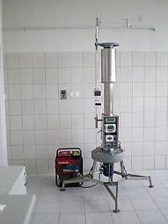
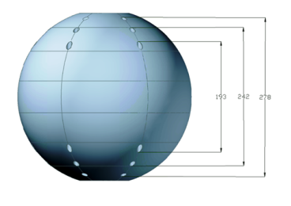
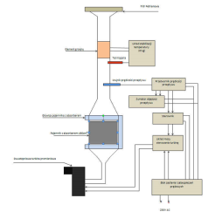
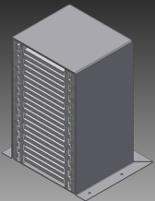
16
PROJECT DELIVERABLES
30 | Reports, Technical documentation, Polish Accreditation Center certificates, Certificated procedures
17 | Expertises
4 | Demonstration models

Slide 17
17
Project Add-in values
 |  | Implementation of innovative technology and measurement methods for: protection of public health protection of natural resources and environment
 |  | Development of modern infrastructure and technical and scientific background for assessment and control of Nuclear Power Plant impact to population and environment
 |  | Integration of research and development centres as technical and scientific support (TSO) of Nuclear Safety and Radiological Protection
 |  | Development of polish scientific specialties as: neutron dosimetry (active and passive) technology of radiation detectors research of biological efects and interaction with radiation
On each stage of nuclear power implementation in Poland

Slide 18
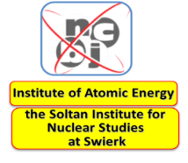
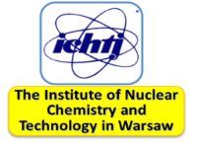
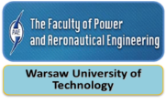
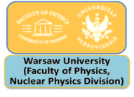
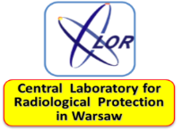
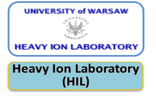
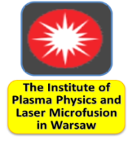
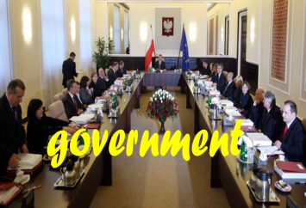
18
CASE OF POLAND
The complex and numerous net of the institutions that might play essential role as potential TSOs

Slide 19
THANKS
FOR YOURS ATENTION
PAWEŁ KRAJEWSKI
CENTRAL LABORATORY FOR RADIOLOGICAL PROTECTION

